Slide 1


SECURE SOFTWARE DEVELOPMENT (SSD)
Diploma in CSF
Academic Year (AY) 20/21 – Semester 3 (April `20)
Week 11
Secure software coding
Last Updated: 22/06/2020

Slide 2
Contents
Defensive Coding Practices – Concepts and Techniques
Secure Software Processes
Remote Learning Instructions
Mission 11.1

Slide 3
Remote Learning Instructions
Step 1
Read Defensive Coding Practices – Concepts and Techniques
More details in slides 5-20
Step 2
Read Secure Software Processes
More details in slides 21-28
Step 3
Do Mission 11.1
More details in slide 30

Slide 4
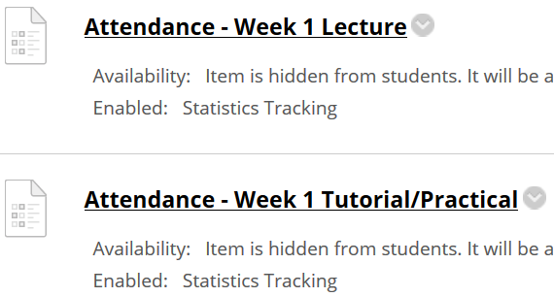
Important Details
VERY IMPORTANT
Visit MEL to start each week’s lesson. Learning materials will ONLY be released in MEL
Attendance Poll Attempt TWO attendance polls every week Starts Monday (9am) till Friday (11:59pm) Attendance :– Week x Lecture ( x refers to week number) Week x Tutorial/Practical Just click “Save and Submit”
Always lookout for announcements Do keep abreast of announcements in MEL
In light of the Covid-19 situation, your cooperation in adhering to the points mentioned is much needed and greatly appreciated.

Slide 5
Defensive Coding Practices – Concepts and Techniques
Defensive coding practices and techniques are used in reducing the attack surface and assuring the reliability, resiliency and recoverability of software.
Input Validation
Sanitization
Error Handling
Exception Management
Session Management
Read Defensive Coding Practises

Slide 6
Input Validation
When it comes to software, we must in fact consider all input as evil and validate all user input.
Input validation is the verification process that ensures the data that is supplied:
for processing is of the correct data type and format
falls within the expected and allowed range of values
is not interpreted as code as is the case with injection attacks
does not masquerade in alternate forms that bypass security controls

Slide 7
Input Validation - How to Validate?
This process of verification can be achieved using filtration techniques. Regular expressions (RegEx) can be used for validating input.

Slide 8
Input Validation - How to Validate?
Filtering user input can be accomplished using either a whitelist or a blacklist.
A whitelist is a list of allowable good and non-malicious characters, commands or data patterns that are allowed. For example, the application will allow only ‘@’ and ‘.com’ in the email field. Items in a whitelist are known and usually deemed to be non-malicious in nature.
On the other hand, a blacklist is a list of disallowed characters, commands or data patterns that are considered to be malicious. Examples include the single quote ( ‘ ), SQL comment ( - - ) or a pattern such as (1=1).

Slide 9
Input Validation - Where to Validate?
The point at which the input is validated is also critically important.
It is best recommended that the input is validated both on the client (frontend) as well as on the server(backend) if the software is a Client/Server architected solution.
Minimally, server side validation must be performed.
It is insufficient to validate input solely on the client side as this can be easily bypassed and afford minimal to no protection.

Slide 10
Input Validation - What to Validate?
One can validate pretty much for anything from generic whitelist and blacklist items to specific business defined patterns.
When validating input, the supplied input must at a bare minimum be validated for:
data type
range
length
format
values
alternate representations of a standard (canonical) form

Slide 11
Sanitization
Input sanitization is the process of transforming the data that is supplied by the user before it is processed.
Input sanitization can be accomplished using any one of the following methods:
Stripping: Removing harmful characters from user supplied input
By stripping the potentially harmful characters such as ‘<’, ‘>’, ‘(‘, ‘)’, ‘’’, ‘;’ and ‘/’, the attacker’s input becomes
Substitution: Replacing user supplied input with safer alternatives
By replacing the single quote quote ( ‘ ), with a double quote ( ‘’ )
Literalization: Using properties that render the user supplied input to be treated as a literal form.

Slide 12
Sanitization
An example for literalization
Input sanitization in web applications, includes the conversion of the input into its innerText form, instead of its innerHTML form. This renders the input to be non-executable and treats the user-supplied input as a literal when it is processed and reflected on the client.
Output sanitization is usually performed by encoding the data before it is presented to the client.
In HTML entity encoding, the meta-characters and HTML tags are encoded to (substituted with) their corresponding character entity references.
For example, in HTML entity encoding, the character ‘<’ is encoded to its corresponding HTML equivalent, which is ‘&lt;’ and ‘>’ is encoded to “&gt;”.

Slide 13
Sanitization
In Url Encoding, encoding is applied to parameters and values that are transmitted as part of the HTTP Query (URL).
Characters that are not permitted in the URLs can be encoded into their Unicode Character set code.
For example, in URL encoding, the character ‘<’ is encoded to its corresponding URL equivalent which is “%3C” and ‘>’ is encoded to “%3E.”

Slide 14
Error Handling
Error messages are one of the first sources an attacker will look to determine the information about the software.
Without proper handling of input and the response generated from that input in the form of an error message, sensitive information can be leaked.
Validate all input to prevent an attacker from forcing an error by using an input (type, value, range, length, etc.) that the software is not expecting.

Slide 15
Error Handling
Use non-verbose error messages with just the needed information. System generated errors with stack information and code paths must be abstracted into generic user friendly error messages that are laconic, with just the needed information.
It is recommended as a best practice to redirect errors and exceptions to a custom and default error handling location and depending on the context of where the user has logged in (remote or local), appropriate message details can be displayed.

Slide 16
Error Handling
An example of a verbose error message would be displaying ‘User ID did not match’ or ‘Password is incorrect’, instead of using the non-verbose or laconic equivalent such as ‘Login invalid’.

Slide 17
Exception Management
While errors may be a result of user ignorance or software breakdown, exceptions are software issues that are not handled explicitly when the software behaves in an unintended or unreliable manner.
An example of user error is that the user mistypes his user ID when trying to log in.
Now if the software was expecting the user ID to be supplied in a numeric format and the user typed in alpha characters in that field, the software operations will result in a data type conversion exception.
If this exception is not explicitly handled, it would result in informing the user of this exception and in many cases disclose the entire exception stack.
This can result in information disclosure potentially revealing the software’s internal architectural details and in some cases even the data value.

Slide 18
Exception Management

Slide 19
Exception Management
Handle all exceptions preferably with a common approach.
All exceptions must be explicitly handled. If the programming language allows for try-catch-finally constructs then there must be a catch all exception block.

Slide 20
Session Management
Just because someone is authenticated and authorized to access system resources does not mean that security controls can be relaxed after an authenticated session is established, because a session can be hijacked.
Session hijacking attacks happen when an attacker impersonates the identity of a valid user and interjects themselves into the middle of an existing session, routing information from the user to the system and from the system to the user through them. This can lead to information disclosure (confidentiality threat), alteration (integrity threat) or a denial of service (availability threat). It is also known as a man-in-the-middle (MITM) attack.
Session management is a security concept that aims at mitigating session hijacking or MITM attacks. It requires that the session is unique by the issuance of unique session tokens and it also requires that user activity is tracked so that someone who is attempting to hijack a valid session is prevented from doing so.

Slide 21
Secure Software Processes
In addition to writing secure code, there are certain processes that must be conducted during the implementation phase that can assure the security of the software. These include:
- Versioning (Configuration Management)
- Code analysis
- Code/Peer review
Read Secure Software Processes

Slide 22
Secure Software Processes
In addition to writing secure code, there are certain processes that must be conducted during the implementation phase that can assure the security of the software.
These include:
Versioning (Configuration Management)
Code analysis
Code/Peer review

Slide 23
Versioning
Versioning or version control of software not only ensures that the development team is working with the correct version of code
It also gives the ability to rollback to a previous version should there be a need to.
Additionally, software versioning provides the ability to track ownership and changes of code.
Version control can reduce the incidences of a condition known as regenerative bugs, where previously fixed bug reappear (are regenerated). This is known to occur when bug fixes are inadvertently overwritten when the correct version of code is not used.

Slide 24
Versioning
Well known examples of version control software include: Visual SourceSafe (VSS), Concurrent Versions System (CVS), StarTeam and Team Foundation Server (TFS).

Slide 25
Code Analysis
Code analysis is the process of inspecting the code for quality and weaknesses that can be exploited. It is primarily accomplished by two means
Static code analysis
Dynamic code analysis

Slide 26
Code Analysis - Static
Static code analysis involves the inspection of the code without executing the code (or software program).
This analysis can be performed manually by what is called a code review or in an automated manner using tools.
The benefits of performing static code analysis are that errors and vulnerabilities can be detected early and addressed before the deployment of the software.
Nowadays, static code analysis functionality is being provided as part of the integrated development environment (IDE) itself.
This helps in the detection of security bugs early in the lifecycle, during the development phase itself
Besides providing immediate feedback to the development staff that learn from the feedback and overtime, develop more secure code.

Slide 27
Code Analysis - Dynamic
Dynamic code analysis is the inspection of the code when it is being executed (run as a program).
Dynamic code analysis can be performed to ascertain that the code is reliably functioning as expected and is not prone to errors or exploitation.
In order to accurately perform dynamic analysis, a simulated environment that mirrors the production environment where the code will be deployed is necessary.

Slide 28
Code/Peer Review
A code review is also referred to as a peer review when peers from the development team are part of the code review process.
A code review can be performed manually or using tools. It is a systematic evaluation of the source code with the goal of finding out syntax issues and weaknesses in the code that can impact the performance and security of the software.
When a code review is conducted for security reasons, the code must at a bare minimum be inspected for the following:
Insecure code
Inefficient code
Logic bombs

Slide 29
Open-Ended Question
Qn 1: In performing static code analysis, code vulnerabilities can be detected early. Explain why is it important to detect code vulnerability early?
Attempt the open-ended question above.
Submit your answers in Teams group.
SSD-AY2021-xxx-Pxx → Week 11
Use “Conversations” tab under “SSD-AY1920-xxx-Pxx → Week 11” to discuss within your class group.

Slide 30
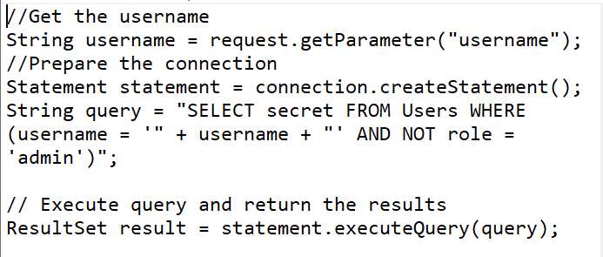
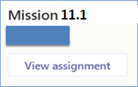
Mission 11.1: Code Review
Attempt the following questions:-
Perform static code analysis on the code below.
Determine what vulnerability exists in the code.
How would you mitigate the vulnerability in the code?
Answer the questions in a word document.
Deadline: Submit in MEL at end of Week 11
Penalty for late submission
If you got any issues regarding Mission 11.1
Use “Conversations” tab under “SSD-AY1920-xxx-Pxx → Week 11” to discuss within your class group.
Tutors would also monitor these “Conversations”

